Slide 1
Object Oriented Programming
Prof. Varsha Dange

Slide 2
Section 2 Lecture – 21
Prof. Varsha Dange

Slide 3
Exception Handling
Exception is an abnormal condition.
Exception is an event that It terminates the program abnormally and rest of program will not executed.
disrupts the normal flow of the program during program execution.
Exception Handling - handle the exception so that normal flow of the program can be executed.
Two ways for exception handling-using : try-catch ,using throws

Slide 4
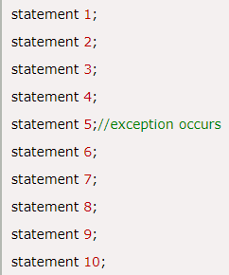
Advantage of Exception Handling
To maintain the normal flow of the application.
An exception normally disrupts the normal flow of the program that is why we use exception handling.
In eg, statement 6 to 10 will not be executed.

Slide 5
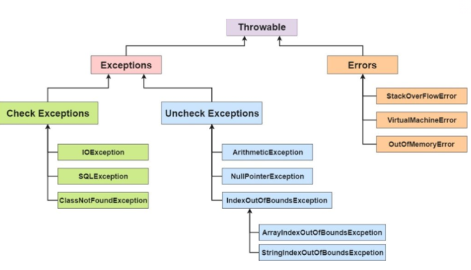
Exception Hierarchy

Slide 6
Contd…
Throwable is the super class.
Difference between error and exception
Errors indicate that something severe enough has gone wrong, the application should crash rather than try to handle the error.
Eg. OutOfMemoryError , VirtualMachineError etc.
Exceptions are events that occurs in the code. A programmer can handle such conditions and take necessary corrective actions.

Slide 7
Types of exceptions
there are three types of exceptions:
Checked Exception
Unchecked Exception
Error

Slide 8
Checked exceptions
Checked exceptions are those exceptional conditions that are checked by compiler at the compile time.
A checked exception forces you to either use try-catch or throws keyword.
All exceptions except Error, RuntimeException , and their subclasses are checked exceptions.
e.g. – IOException, SQLException etc.

Slide 9
Unchecked exceptions
Unchecked exceptions are those exceptional conditions that are not checked by compiler at the compile time.
Unchecked exceptions are checked at runtime.
An unchecked exception not forces you to either use try-catch or throws.
RuntimeException and their subclasses are unchecked exceptions.
e.g. – NullPointerException, ArithmeticException etc.

Slide 10
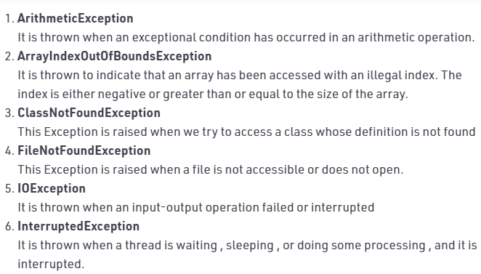
Built-in Exceptions

Slide 11
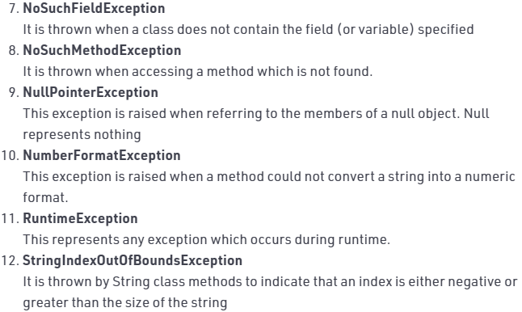
Built-in Exceptions

